Slide 1

Effective and Active Spin
By, Daniel Palombo

Slide 2

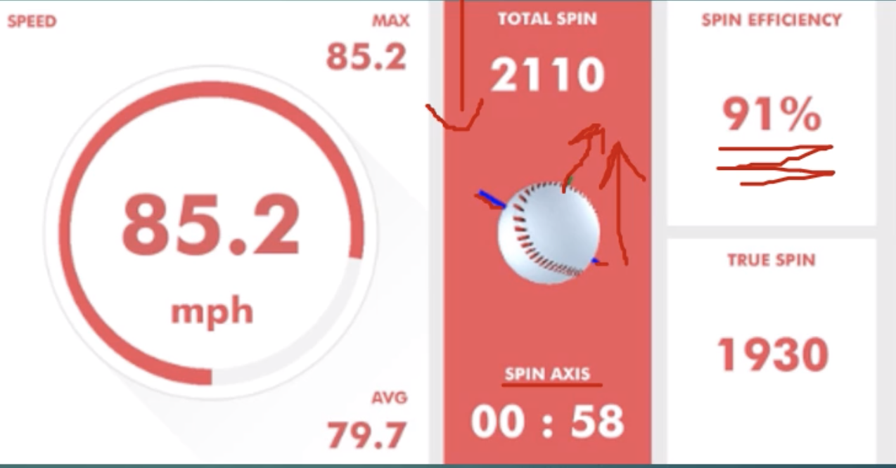
What makes a pitch?
A pitch consists of three general components:
Velocity (speed)
Spin axis/direction (direction of movement)
Spin rate (amount of movement)
However, spin rate can be broken down further:
Raw spin (total spin)
Active spin (spin contributing to movement)
Spin efficiency (active spin as a percent of raw spin)

Slide 3

What is Raw Spin?
Simply put, the total spin on the pitch, this includes:
Transverse spin
Gyroscopic spin
Transverse spin is, essentially, spin that creates movement on the pitch
Gyroscopic spin, also known as “bullet spin” (like a football spiral), doesn’t cause movement on the pitch

Slide 4

What is Active Spin?
Active spin only includes transverse spin, or spin that affects the pitch’s movement
The more active spin on a 12-6 curveball, the further down it curves
The more active spin on a true four-seam fastball, the more it appears to “rise” or defy gravity

Slide 5
What is Spin Efficiency?
Spin efficiency is how efficiently a pitch spins, or how much of its raw spin contributes for movement (active spin)
Therefore, we see more swings and misses and mishits on pitches with more spin and spin efficiency on certain pitches

Slide 6
Hypothesis and Findings
Initially, I set out to find if spin rate or efficiency over the course of a game could indicate pitcher fatigue or dramatic decline in effectiveness
However, I found evidence that while active spin generally decreases as a pitcher becomes more fatigued, it appears a pitcher who is more efficient in his mechanics (Trevor Bauer) can maintain his performance for a longer period than a pitcher with less efficient mechanics (Noah Syndergaard)
For this reason, I highlight Syndergaard and Bauer in the data

Slide 7
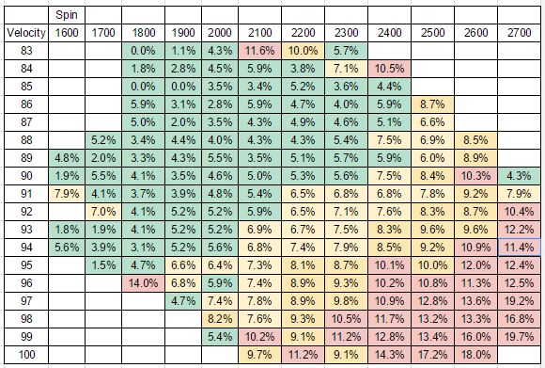
Swinging Strike % vs. Spin Rate
https://www.drivelinebaseball.com/2016/11/spin-rate-what-we-know-now/

Slide 8
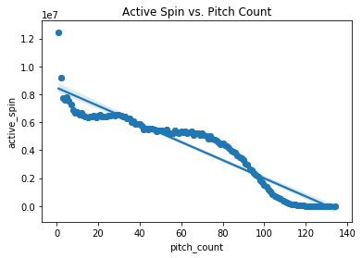
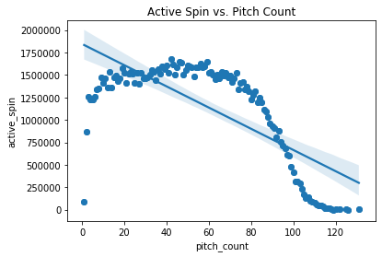
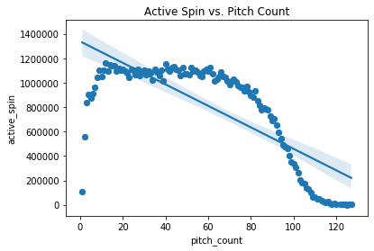
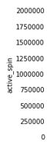
MLB Average Active Spin by Pitch
Fast Ball
Curve Ball
Slider

Slide 9
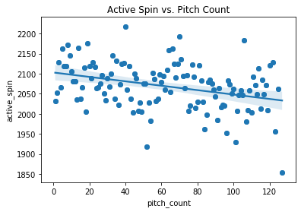
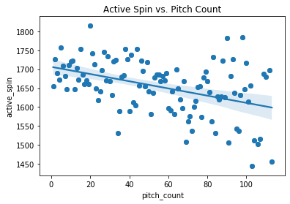
Trevor Bauer Fast Ball vs. Noah Syndergaard Fast Ball using Active Spin
Trevor Bauer
Noah Syndergaard

Slide 10
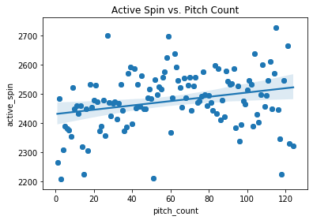
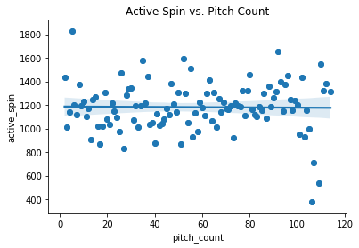
Trevor Bauer Curve Ball vs. Noah Syndergaard Curve Ball Active Spin
Trevor Bauer
Noah Syndergaard

Slide 11
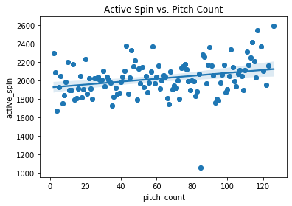
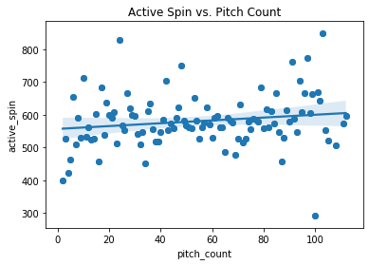
Trevor Bauer Slider vs. Noah Syndergaard Slider using Active Spin
Trevor Bauer
Noah Syndergaard

Slide 12
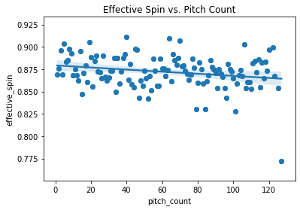
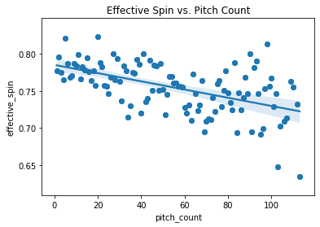
Trevor Bauer Fast Ball vs. Noah Syndergaard Fast Ball Effective Spin
Trevor Bauer
Noah Syndergaard

Slide 13
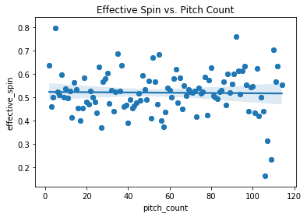
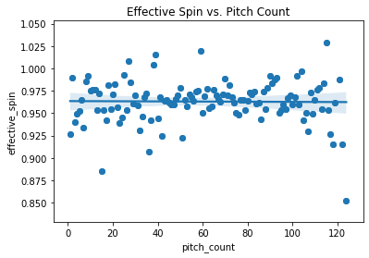
Trevor Bauer Curve Ball vs. Noah Syndergaard Curve Ball Effective Spin
Trevor Bauer
Noah Syndergaard

Slide 14
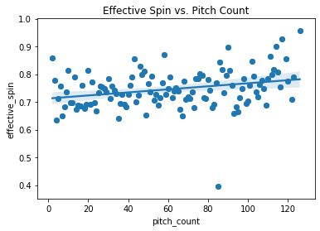
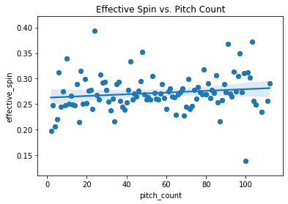
Trevor Bauer Slider vs. Noah Syndergaard Slider using Effective Spin
Trevor Bauer
Noah Syndergaard

Slide 15

Conclusion
Higher spin gives the pitcher an advantage over the batter.
Bauer is able to generate much more active and effective spin than Syndergaard.
Bauer is able to maintain a higher Fast Ball effective and active spin at the same throughout the whole game.
Bauer is able to maximize his effective and active spin more consistently on his fastball, curveball, and slider than Syndergaard over the course of two years.

